Slide 1
RDF

Slide 2
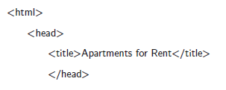
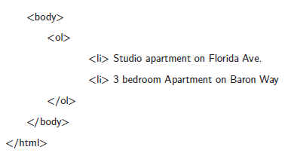
HTML is the standard language in which web pages are written.
There are three components that HTML and any exchange language has: a syntax, a data model, and a semantics.

Slide 3
The data model of HTML, known as the Document Object Model, defines the organization of these elements defined by tags into a hierarchical tree structure.
For example, <head> should come before <body> and <li> elements should appear within <ol> elements.
Finally, the semantics of HTML tell us how the browser should interpret the web page.
For example, the browser should render the content of the web page’s body within the browser window and <ol> elements should be displayed as an ordered list.

Slide 4
For the Semantic Web, we need something richer. We need a data model that can be used by multiple applications, not just for describing documents for people but for describing application-specific information.
This data model needs to be domain independent so that applications ranging from real estate to social networks can leverage it.

Slide 5
In addition to a flexible data model, we also need a mechanism to assign semantics to the information represented using this data model.
It should allow users to describe how an application should interpret “friend” in a social network description and “city” in a geographical description. Finally, like HTML, we need a way to write down all this information – a syntax.
RDF (Resource Description Framework) provides just such a flexible domain independent data model. Its basic building block is an entity-attribute-value triple, called a statement.

Slide 6
RDF: Data Model
The fundamental concepts of RDF are resources, properties, statements, and graphs.
Resources :
We can think of a resource as an object, a “thing” we want to talk about. Resources may be authors, apartments, tennis players, places, people, hotels, search queries, and so on.
Every resource has a URI.
A URI can be a URL (Uniform Resource Locator, or web address) or another kind of unique identifier.

Slide 7
It enables users to either retrieve a resource itself (in the case of an image) or a further description of that resource (in case of a person).
The use of URIs is one of the key design decisions behind RDF. It allows for a global, worldwide unique naming scheme.

Slide 8
Properties :
Properties are a special kind of resource; they describe relations between other resources – for example, “friend of,” “written by,” and “located in.”
Like all resources, properties are identified by URIs. We can also dereference property URLs to find their descriptions.

Slide 9
Statements
Statements assert the properties of resources. A statement is an entity-attribute-value triple, consisting of a resource, a property, and a value.
The value can either be a resource or a literal. Literals are atomic values – for example, numbers, strings, or dates.
“The Baron Way Building is located in Amsterdam.”

Slide 10
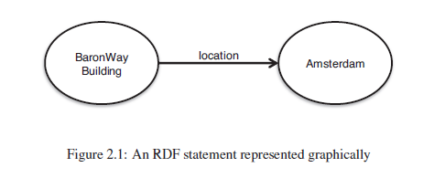
In figure 2.1, labeled nodes are connected by labeled arcs. The arcs are directed from the subject of the statement to the object of the statement, with the label on the arc to the statement’s property.
The labels on the nodes are the identifiers of the subject and object. The object of a statement can be the subject of another statement.

Slide 11
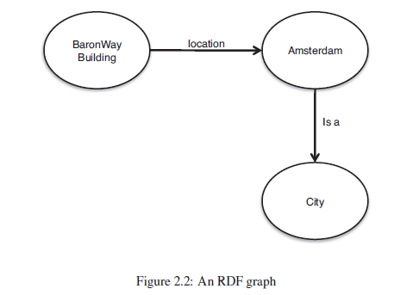

Slide 12
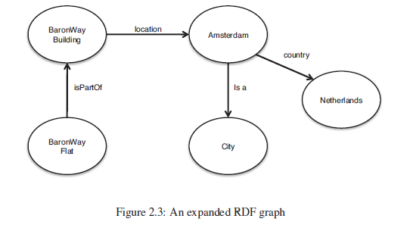

Slide 13
Importantly, this graph can be created in a distributed fashion by multiple different participants just by using the same URLs. This allows us to create a Web of Data allowing for knowledge to be reused;
There is a set of best practices, called the Linked Data principles,1 that encourage us to reuse and make available information to help create this global graph.
1. Use URIs as names for things.
2. Use HTTP URIs so that people can look up those names.
3. When someone looks up a URI, provide useful information, using the standards (RDF).
4. Include links to other URIs so that they can discover more things.

Slide 14
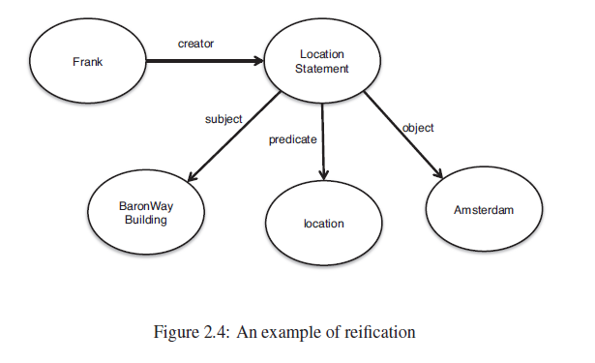

Slide 15
RDF Syntaxes
We have already seen one syntax for RDF, namely, a graphical syntax. This syntax is, however, neither machine interpretable nor standardized.
Here, we introduce a standard machine interpretable syntax called Turtle.

Slide 16
Turtle
Terse RDF Triple Language (Turtle) is a text-based syntax for RDF. The file extension used for Turtle text files is “.ttl”.
<http://www.semanticwebprimer.org/ontology/apartments.ttl#BaronWayBuilding>
<http://dbpedia.org/ontology/location>
<http://dbpedia.org/resource/Amsterdam>.

Slide 17
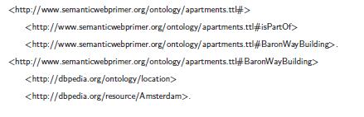
URLs are enclosed in angle brackets. The subject, property, and object of a statement appear in order, followed by a period.

Slide 18
Literals
We can also include literals, that is, atomic values within RDF.
In Turtle, we write this down by simply enclosing the value in quotes and appending it with the data type of the value.
A data type tells us whether we should interpret a value as string, a date, integer or some other type.
If no data type is specified after a literal, it is assumed to be a string.

Slide 19



Slide 20
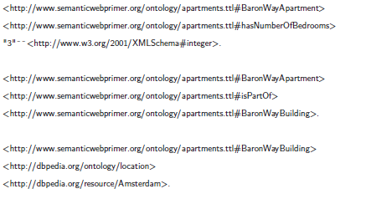
Suppose that we want to add to our graph that the Baron Way Apartment has three bedrooms. We would add the following statement in Turtle to our graph.

Slide 21
Abbreviations
In our example, the resources Baron Way Apartment and Baron Way Building are both defined at the URL http://www.semanticwebprimer.org/ontology/apartments.ttl.
It introduces the @prefix syntax to define short stand-ins for particular namespaces. For example, we can say that swp should be the stand-in for http://www.semanticwebprimer.org/ontology/apartments.ttl.
Such a stand-in is termed a qualified name.

Slide 22
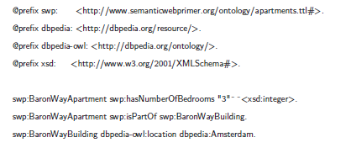
Below is a rewrite of our example using prefixes.

Slide 23
Turtle also allows us to not repeat particular subjects when they are used repeatedly.
In the example above, swp:BaronWayApartment is used as the subject of two triples.
This can be written more compactly by using a semicolon at the end of a statement.

Slide 24
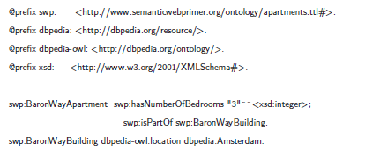

Slide 25
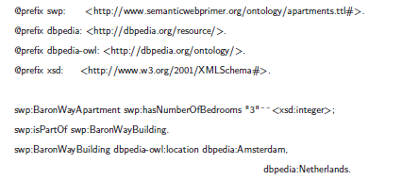
If both a subject and predicate are used repeatedly, we can use a comma at the end of a statement.
For instance, if we want to extend our example to say that Baron Way Building is not only located in Amsterdam but also in the Netherlands, we can write the following Turtle:

Slide 26
Named Graphs
For example, we might want to say that our statements about the Baron Way Apartment were created by a person, Frank, identified by the URL http://www.cs.vu.nl/~frankh.
We do this by putting brackets around the set of statements we want and assigning that set of statements a URL.
Let’s look at an example:

Slide 27
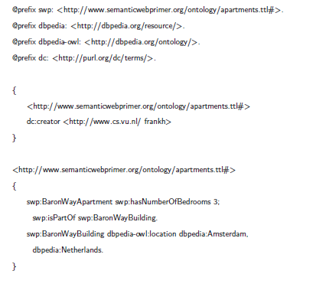

Slide 28
Other Syntaxes
There are a number of other syntaxes that we can use to write down RDF.
Among them are two other standard syntaxes: RDF/XML and RDFa.

Slide 29
RDF/XML
RDF/XML is an encoding of RDF in the XML language. This allows RDF to be used with existing XML processing tools.
Subjects are denoted by the rdf:about within an rdf:Description element (enclosed in brackets).
Predicates and objects related to that subject are enclosed in the rdf:Description element.
Namespaces can be used through the XML namespaces (xmlns:) construct.
All RDF/XML should be enclosed in an element rdf:RDF.

Slide 30
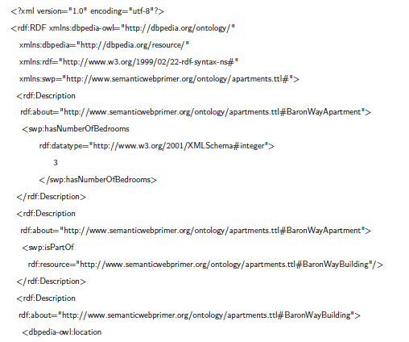

Slide 31
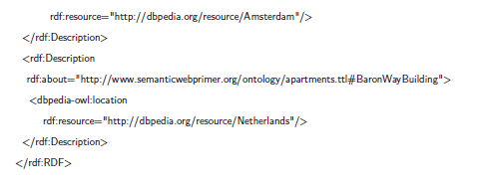

Slide 32

RDFa
RDFa embeds RDF within the attributes of HTML tags

Slide 33
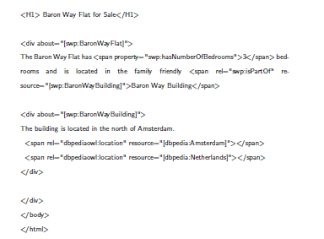

Slide 34
RDFS: Adding Semantics
RDF is a universal language that lets users describe resources using their own vocabularies.
RDF does not make assumptions about any particular application domain, nor does it define the semantics of any domain.
In order to specify these semantics, a developer or user of RDF needs to define what those vocabularies mean in terms of a set of basic domain independent structures defined by RDF Schema.

Slide 35
Classes and Properties
How do we describe a particular domain? Let us consider a domain of apartment rentals.
First we have to specify the “things” we want to talk about.
Here we make a first, fundamental distinction.
On one hand, we want to talk about particular apartments, such as the BaronWay Apartment, and particular locations, such as Amsterdam; we have already done so in RDF.

Slide 36
But we also want to talk about apartments, buildings, countries, cities, and so on.
What is the difference?
In the first case we talk about individual objects (resources), and in the second we talk about classes that define types of objects.
A class can be thought of as a set of elements. Individual objects that belong to a class are referred to as instances of that class.
RDF provides us a way to define the relationship between instances and classes using a special property rdf:type.

Slide 37
An important use of classes is to impose restrictions on what can be stated in an RDF document using the schema.
After all, we would like to disallow statements such as:
Baron Way Apartment rents Jeff Meyer
Amsterdam has number of bedrooms 3
The first statement is nonsensical because buildings do not rent people. This imposes a restriction on the values of the property “rents.”
The second statement is nonsensical because cities do not have bedrooms. This imposes a restriction on the objects to which the property can be applied.

Slide 38
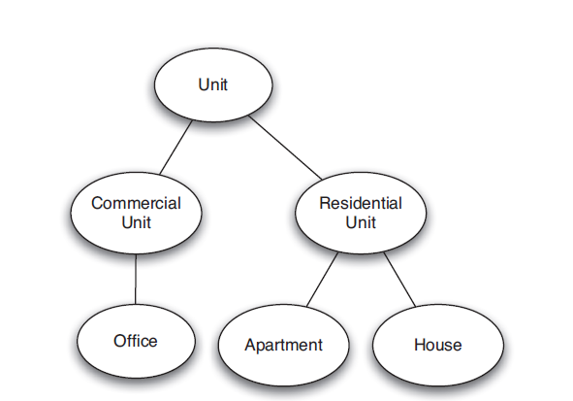
Class Hierarchies and Inheritance
Once we have classes, we would also like to establish relationships between them.

Slide 39
In general, A is a subclass of B if every instance of A is also an instance of B.
There is no requirement in RDF Schema that the classes together form a strict hierarchy.
In other words, a subclass graph as in figure 2.5 need not be a tree.
A class may have multiple superclasses. If a class A is a subclass of both B1 and B2, this simply means that every instance of A is both an instance of B1 and an instance of B2.

Slide 40
A hierarchical organization of classes has a very important practical significance.
Consider the range restriction
“People can only rent residential units.”
Suppose Baron Way Apartment is defined as an apartment.
Then, according to the preceding restriction, it does not qualify as a Residential Unit because there is no statement specifying that the Baron Way Apartment is also a residential unit.

Slide 41
We would like the Baron Way Apartment to inherit the ability to be rented from the class of residential units. Exactly this is done in RDF Schema.
By doing so, RDF Schema fixes the semantics of “is a subclass of.”
RDF Schema is a primitive ontology language.
In RDFS, properties are defined globally. That is, they are not encapsulated as attributes in class definitions.
It is possible to define new properties that apply to an existing class without changing that class.

Slide 42
Property Hierarchies
We saw that hierarchical relationships between classes can be defined. The same can be done for properties.
For example, “rents” is a subproperty of “resides at.” If a person p rents a residential unit r, then p also resides at r.

Slide 43
RDF versus RDFS Layers
Consider the RDF statement
Jeff Meyer rents the Baron Way Apartment.

Slide 44
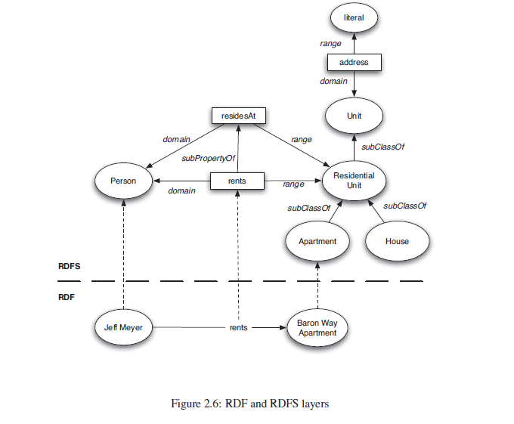

Slide 45
RDF Schema
Core Classes
rdfs:Resource, the class of all resources
rdfs:Class, the class of all classes
rdfs:Literal, the class of all literals (strings)
rdf:Property, the class of all properties
rdf:Statement, the class of all reified statements

Slide 46
Core Properties for Defining Relationships
rdf:type, which relates a resource to its class. The resource is declared to be an instance of that class.
rdfs:subClassOf, which relates a class to one of its superclasses.
All instances of a class are instances of its superclass.
Multiple super class
The class femaleProfessor may be a subclass of both female and professor.

Slide 47
rdfs:subPropertyOf, which relates a property to one of its superproperties.
swp:apartment rdfs:subClassOf swp:ResidentialUnit
It is interesting that rdfs:Class is a subclass of rdfs:Resource (every class is a resource), and rdfs:Resource is an instance of rdfs:Class (rdfs:Resource is the class of all resources, so it is a class!).

Slide 48
Core Properties for Restricting Properties
rdfs:domain, which specifies the domain of a property P and states that any resource that has a given property is an instance of the domain classes.
rdfs:range, which specifies the range of a property P and states that the values of a property are instances of the range classes.
Here is an example stating that whenever any resource has an address, it is (by inference) a unit and that its value is a literal:
swp:address rdfs:domain swp:Unit.
swp:address refs:range rdf:Literal.

Slide 49
Useful Properties for Reification
rdf:subject, which relates a reified statement to its subject
rdf:predicate, which relates a reified statement to its predicate
rdf:object, which relates a reified statement to its object

Slide 50
Container Classes
rdf:Bag, the class of bags,
rdf:Seq, the class of sequences,
rdf:Alt, the class of alternatives,
rdfs:Container, a superclass of all container classes, including the three preceding ones.

Slide 51
Utility Properties
A resource may be defined and described in many places on the web. The following properties allow us to define links to those addresses:
rdfs:seeAlso relates a resource to another resource that explains it.
rdfs:isDefinedBy is a subproperty of rdfs:seeAlso and relates a resource to the place where its definition, typically an RDF schema, is found.

Slide 52
Often it is useful to provide more information intended for human readers. This can be done with the following properties:
rdfs:comment. Comments, typically longer text, can be associated with a resource.
rdfs:label. A human-friendly label (name) is associated with a resource.

Slide 53
Example: Housing
Example: Motor vehicle

Slide 54
An Axiomatic Semantics for RDF and RDF Schema
Refer Text

Slide 55
A Direct Inference System for RDF and RDFS
Refer text

